Slide 1
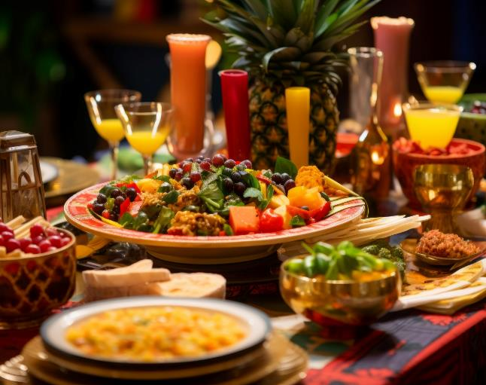

Restaurant Operations Analysis
SQL PROJECT

Slide 2
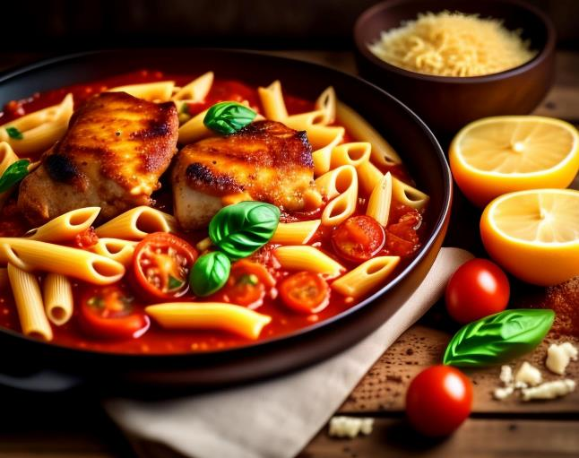
The Taste Of The World Cafe
Dishes starting from $ 5
Order Now

Slide 3
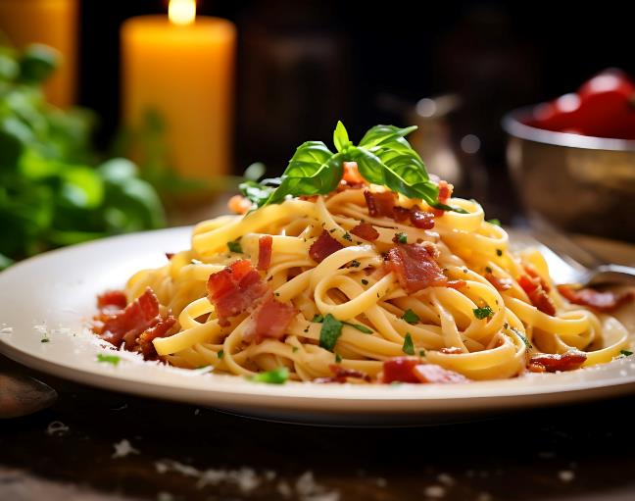
The Assignment
The Taste of the World Café debuted a new menu at the start of the year 2023.
We have been asked to analyze the customer data to see which dishes are doing well and not doing well.

Slide 4
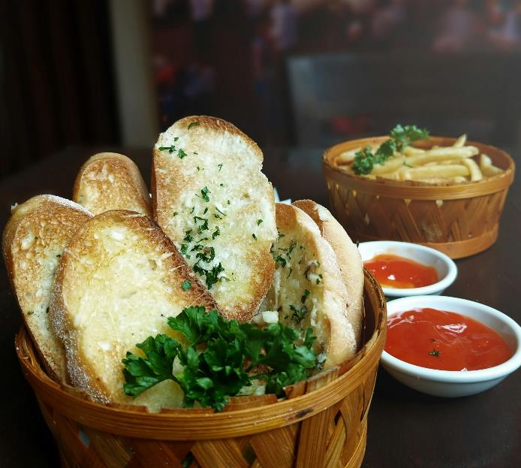
The Objectives
Explore the menu_items table to get an idea of what’s on the menu.
Explore the order_details table to get an idea of price range and date range.
Use both tables to understand how customers are reacting to the new menu.

Slide 5
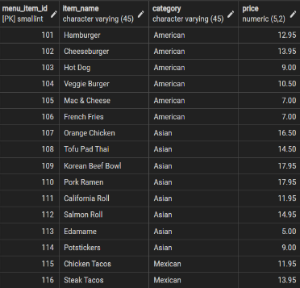
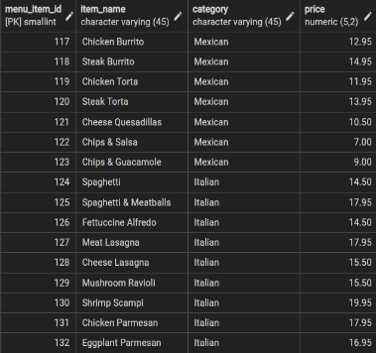

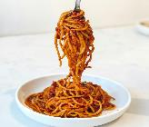
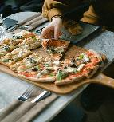
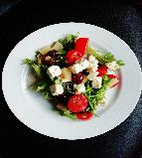
1. Exploring menu_items table
1.Exploring menu_items table
2.Total number of items on the menu.
SELECT * FROM menu_items;
SELECT COUNT(*) FROM menu_items;
Result:
Result:

Slide 6
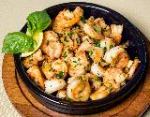
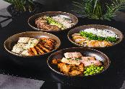
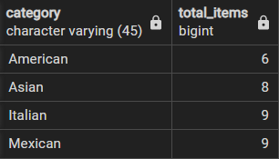
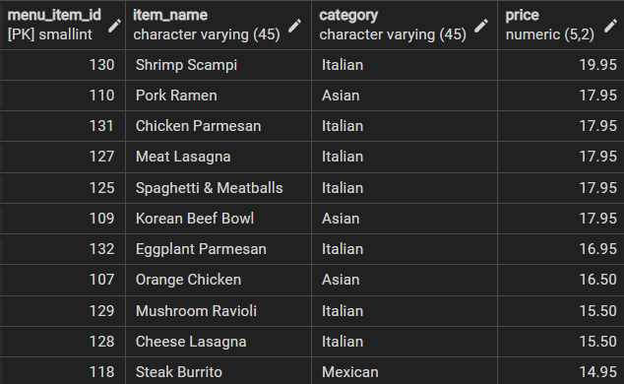
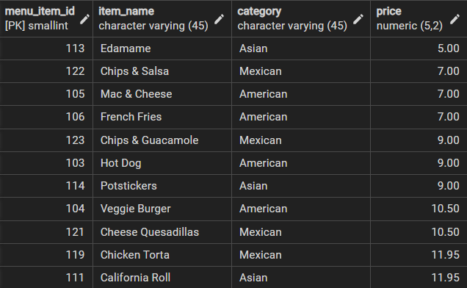
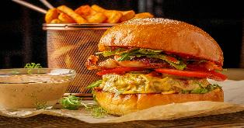
3.How many items are there in each category?
4.What are the most expensive items on the menu?
5.What are the least expensive items on the menu?
SELECT category,
count(DISTINCT item_name) AS total_items
FROM menu_items
GROUP BY category;
SELECT *
FROM menu_items
ORDER BY price DESC;
SELECT *
FROM menu_items
ORDER BY price;
Result:
Result:
Result:

Slide 7
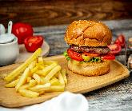
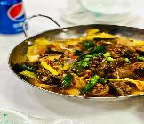
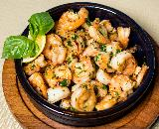
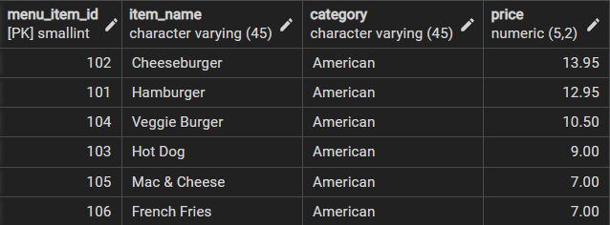
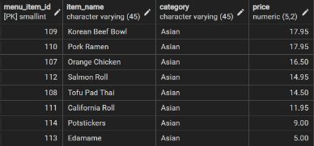
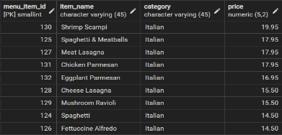
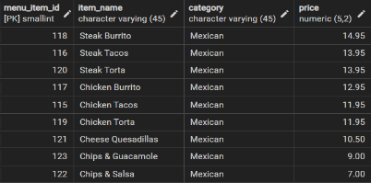
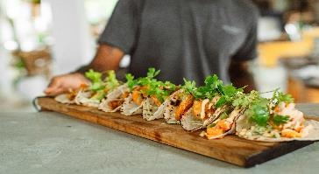
6.a) What are the most and least expensive American items on the menu?
b) What are the most and least expensive Asian items on the menu?
c) What are the most and least expensive Italian items on the menu?
SELECT *
FROM menu_items
WHERE category = ‘American'
ORDER BY price DESC;
SELECT *
FROM menu_items
WHERE category = ‘Asian'
ORDER BY price DESC;
SELECT *
FROM menu_items
WHERE category = ‘Italian'
ORDER BY price DESC;
Result:
Result:
Result:
d) What are the most and least expensive Mexican items on the menu?
Result:
SELECT * FROM menu_items
WHERE category = 'Mexican'
ORDER BY price DESC;

Slide 8
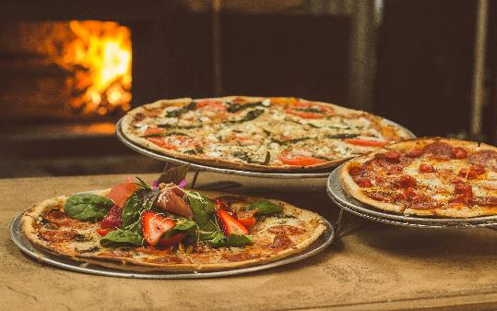
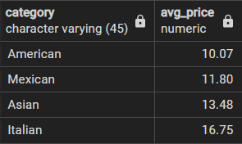
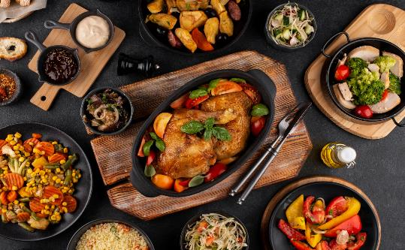
7.What is the average dish price in each category?
SELECT category,
ROUND(AVG(price),2) AS avg_price
FROM menu_items
GROUP BY category;
Result:

Slide 9
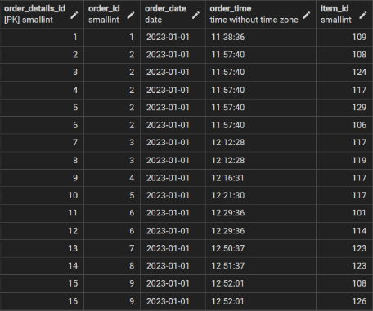




2. Exploring order_details table
1.Exploring order_details table.
2.What is the date range of the table?
3.How many orders were made within this date range?
SELECT * FROM order_details;
SELECT
MIN(order_date) AS start_date, MAX(order_date) AS end_date
FROM order_details;
SELECT COUNT(DISTINCT order_id) AS total_orders FROM order_details;
Result:
Result:
Result:
4.How many items were ordered within this date range?
SELECT COUNT(order_details) AS num_items FROM
order_details;
Result:

Slide 10

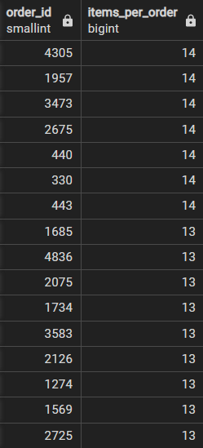
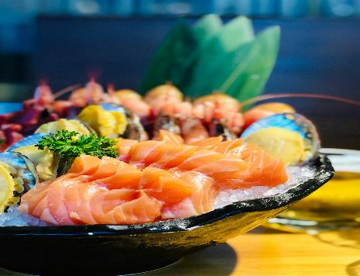
5.What is the maximum number of items per order?
SELECT order_id,
COUNT(item_id) AS items_per_order
FROM order_details
GROUP BY order_id
ORDER BY items_per_order DESC;
Result:

Slide 11
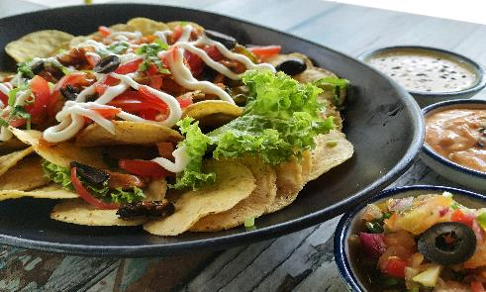
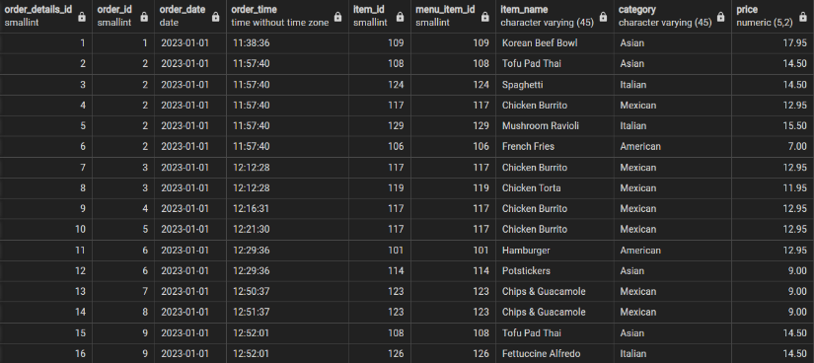

3. Analyzing Customer Behaviour
1. Joining two tables using joins?
SELECT *
FROM order_details od
INNER JOIN menu_items mi
ON od.item_id = mi.menu_item_id;
Result:

Slide 12
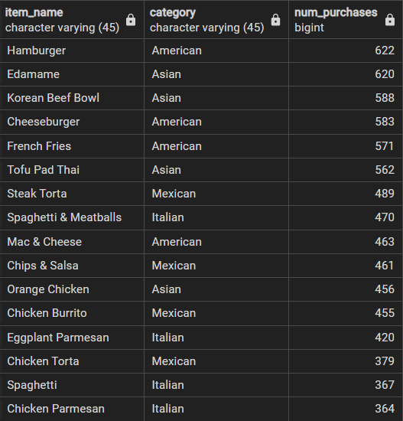
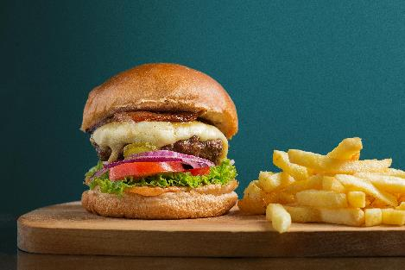
2.What were the most ordered items? What categories were they in?
SELECT item_name,category,
COUNT(order_details_id) AS num_purchases
FROM order_details od
INNER JOIN menu_items mi
ON od.item_id = mi.menu_item_id
GROUP BY item_name, category
ORDER BY num_purchases DESC;
Result:

Slide 13
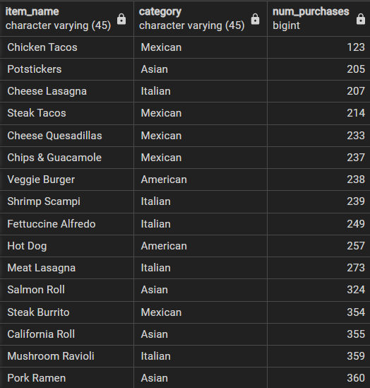
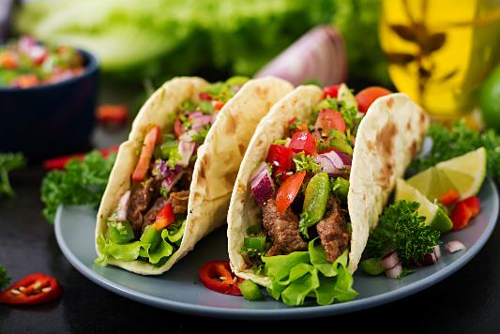
3.What were the least ordered items? What categories were they in?
SELECT item_name,category, COUNT(order_details_id) AS num_purchases
FROM order_details od
INNER JOIN menu_items mi
ON od.item_id = mi.menu_item_id
GROUP BY item_name, category
ORDER BY num_purchases ASC;
Result:

Slide 14
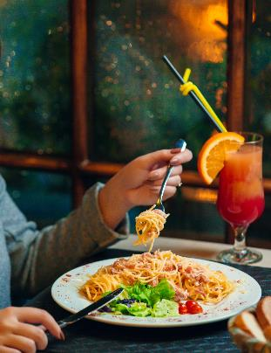
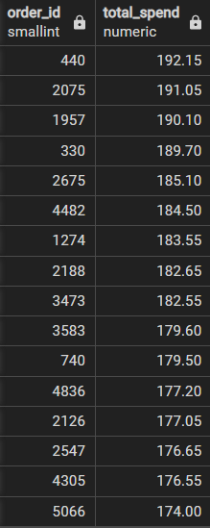
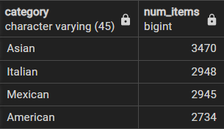
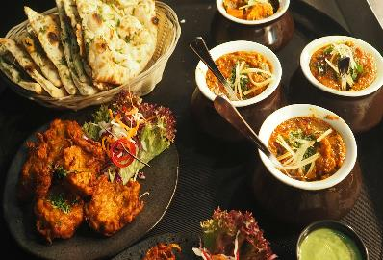
4.What do the highest spending orders look like? How much did they spend?
5.Which category of the items were purchased the most by customers?
SELECT order_id,
SUM(price) AS total_spend
FROM order_details od
INNER JOIN menu_items mi
ON od.item_id = mi.menu_item_id
GROUP BY order_id
ORDER BY total_spend DESC
SELECT category,
COUNT(item_id)AS num_items
FROM order_details od
INNER JOIN menu_items mi
ON od.item_id = mi.menu_item_id
GROUP BY category
ORDER BY num_items DESC;
Result:
Result:

Slide 15
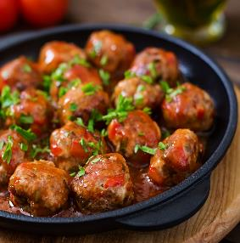
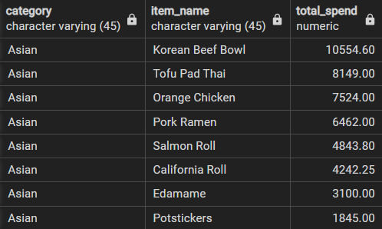
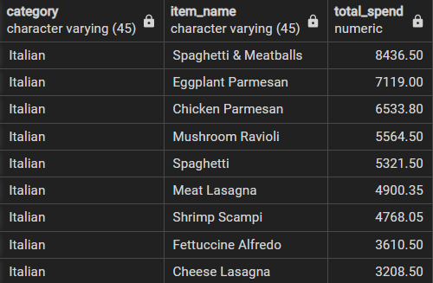
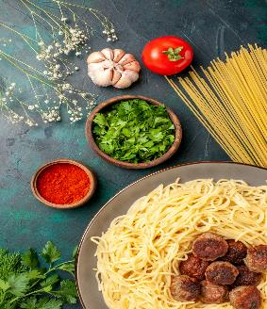
6.a) Which Asian dishes did customers spend the most on?
b) Which Italian dishes did customers spend the most on?
SELECT category,item_name,
SUM(price)AS total_spend
FROM order_details od
INNER JOIN menu_items mi
ON od.item_id = mi.menu_item_id
GROUP BY category,item_name
HAVING category = 'Asian'
ORDER BY total_spend DESC;
SELECT category,item_name,
SUM(price)AS total_spend
FROM order_details od
INNER JOIN menu_items mi
ON od.item_id = mi.menu_item_id
GROUP BY category,item_name
HAVING category = 'Italian'
ORDER BY total_spend DESC;
Result:
Result:

Slide 16

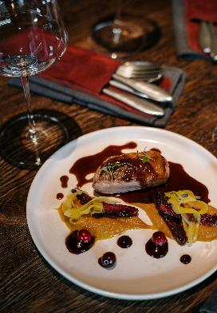
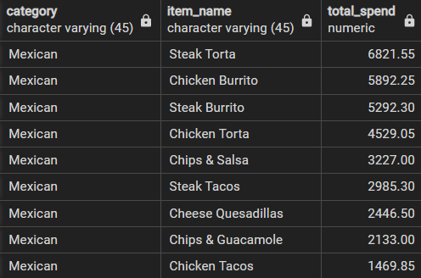
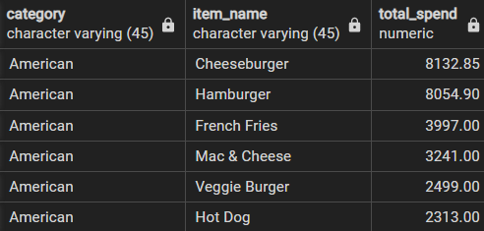
c) Which Mexican dishes did customers spend the most on?
d) Which American dishes did customers spend the most on?
SELECT category,item_name,
SUM(price)AS total_spend
FROM order_details od
INNER JOIN menu_items mi
ON od.item_id = mi.menu_item_id
GROUP BY category,item_name
HAVING category = 'Mexican'
ORDER BY total_spend DESC;
SELECT category,item_name,
SUM(price)AS total_spend
FROM order_details od
INNER JOIN menu_items mi
ON od.item_id = mi.menu_item_id
GROUP BY category,item_name
HAVING category = 'American'
ORDER BY total_spend DESC;
Result:
Result:

Slide 17
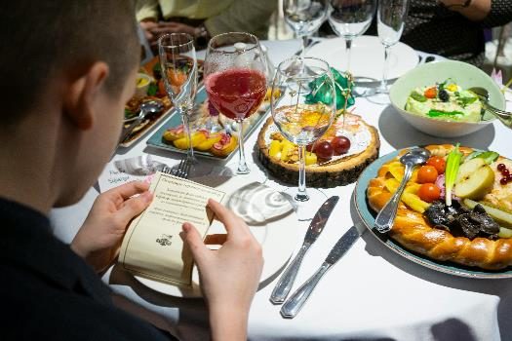
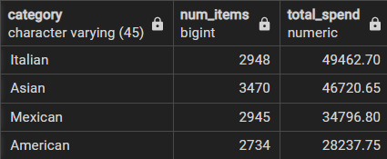
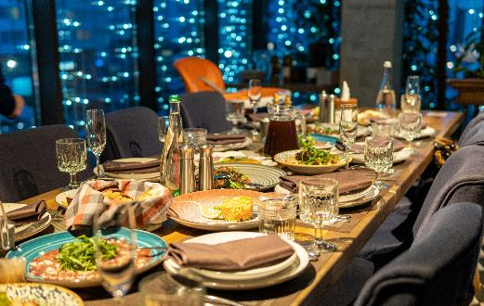
7.Which category did customers spend the most on?
SELECT category,
COUNT(item_name) AS num_items,
SUM(price)AS total_spend
FROM order_details od
INNER JOIN menu_items mi
ON od.item_id = mi.menu_item_id
GROUP BY category
ORDER BY total_spend DESC;
Result:

Slide 18


Insights
There are 32 dishes on the menu.
Count of dishes from different categories American 6 , Asian 8 ,Italian 9 ,Mexican 9
Edamame from Asian is the least expensive ($5)
Shrimp Scampi from Italian is the most expensive ($19.95)
Italian dishes are the most expensive (Average price $16.75)
American dishes are most affordable (Average price $10.07)
Total orders 5370, Number of items ordered 12234
Maximum items per order is 14
Most ordered items are American (Hamburger (622 orders) and Asian (Edamame (620 orders))
Highest spending orders $192.15
‘Customers spent the most on the ‘Korean Beef Bowl’ from Asian category, ‘Spaghetti & Meatballs’ from Italian, ’Steak Torta’ from Mexican, ‘Cheeseburger’ from American.
Despite the higher prices of Italian dishes, customers still prefer to purchase them.
Recommendations
1. Which cuisines should we focus on developing more menu items for based of the data?
American cuisine should consider expanding its menu offerings to meet customer demands.

Slide 19

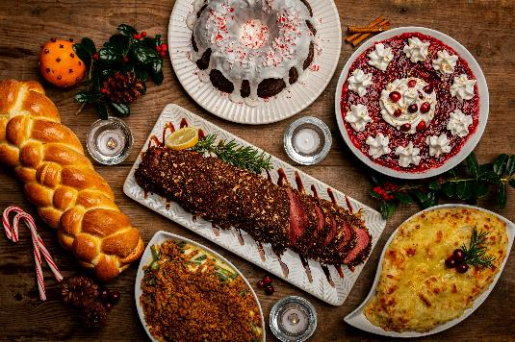
Thank You
SQL Data Analysis
By Amit Kumar

